Slide 1

Ranked Choice Voting 06/01/2016
Final Presentation
Team: Ranked Choice Voting
Donald Peat (Initial Scrum Master)
Jeffrey Guo (Designer)
Drew Moore (Product Owner)

Slide 2
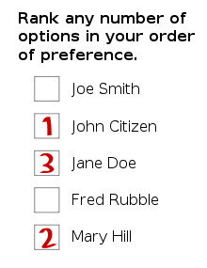
Introduction
Ranked Choice Voting
• A voting system to elect a single candidate from a ranking ballot
• Candidate must win with 50% of the votes to win
• Each round, the candidate with the least votes
is eliminated until a 50% majority is reached
• The eliminated candidate’s votes are then
redistributed based on voters’ next choice

Slide 3
Goals
Allow users to explore the Ranked-Choice Voting process
Create an educational outreach tool to illustrate & advocate an alternative voting method
To provide an example for developers of a reactive/redux approach to web app development

Slide 4
Challenges
Reactive Programming /Angular 2 / Typescript
Integration of new technologies
Time Management & Coordination

Slide 5

Accomplishments
Successfully created RCV logic
Visualizations for RCV process

Slide 6



Technology Used
HTML5
JavaScript
Angular 2
Reactive Programming
Neo4j
Github

Slide 7




Management Techniques
Scrum Methodology
Trello
Google Docs
Slack

Slide 8
What We Enjoyed
Setting clear and simple goals
Reasonable workloads
Breaking down complex tasks
Produce better decision making
Working with a new platform

Slide 9

What We Disliked
Lack of time
Some tasks took longer than expected
Unforeseen obstacles

Slide 10

Lessons learned
Important to break down a project into workable pieces
Consistent communication
It is better to overestimate how long tasks will take
Time management

